Slide 1
Modeling A Colony of Honeybees

Slide 2
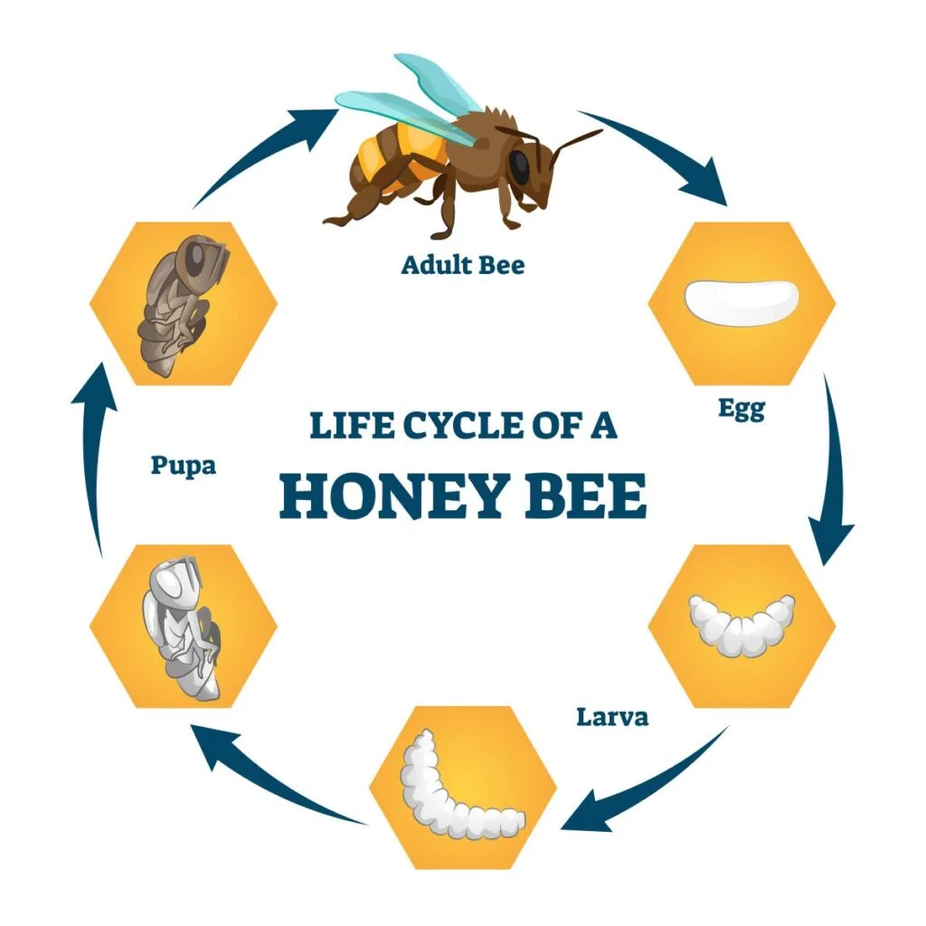
Life Cycle of a Bee

Slide 3
Motivation
Bees pollinate flowering plants – including fruits and vegetables
Their population has massively decreased in the past couple of decades
Modeling can help save them
They make Honey
Bugs are cool

Slide 4
(Some) Parameters
Time Spent in Life Cycle Phase
Survival Rate (or Mortality Rate = 1-(Survival Rate)
Food Consumption per day
Food Gathered Per Day
Eggs Laid Per Day

Slide 5
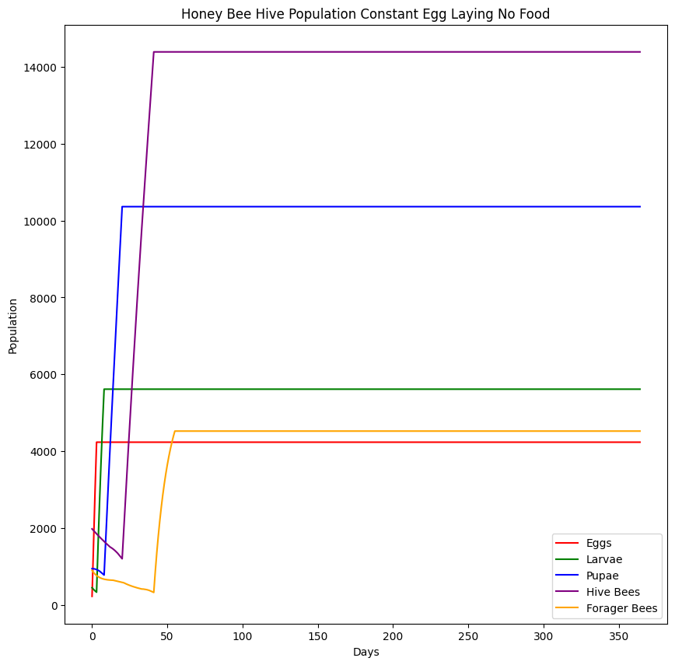
Example with Constant Egg Laying
1500 eggs per day
Initial Population 4500 Bees total
225 Eggs, 450 Larvae, 945 Pupae, 1980 Hive Bees, 900 Forager Bees
94% of Eggs survive, 92% of Larvae survive, 98% of Pupae survive, 98% of Hive bees survive, 90% of Forager Bees survive
No Concerns over Food

Slide 6
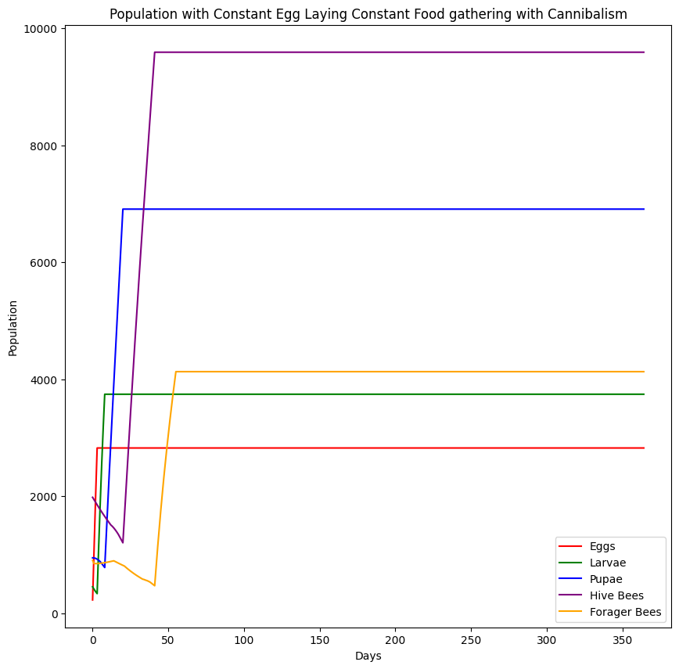
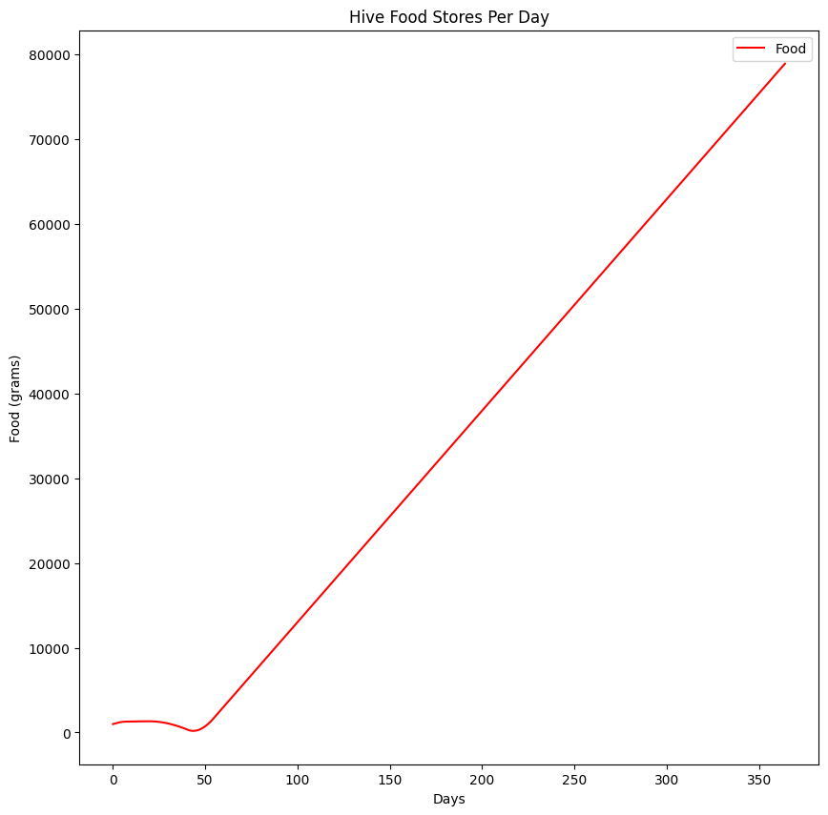
Example Including Food Concerns with Constant Egg Laying
1000 eggs per day
Initial Population 4500 Bees total
1000 grams of food on Day 1
0.1 grams per forager
225 Eggs, 450 Larvae, 945 Pupae, 1980 Hive Bees, 900 Forager Bees
94% of Eggs survive, 92% of Larvae survive, 98% of Pupae survive, 98% of Hive bees survive, 90% of Forager Bees survive

Slide 7
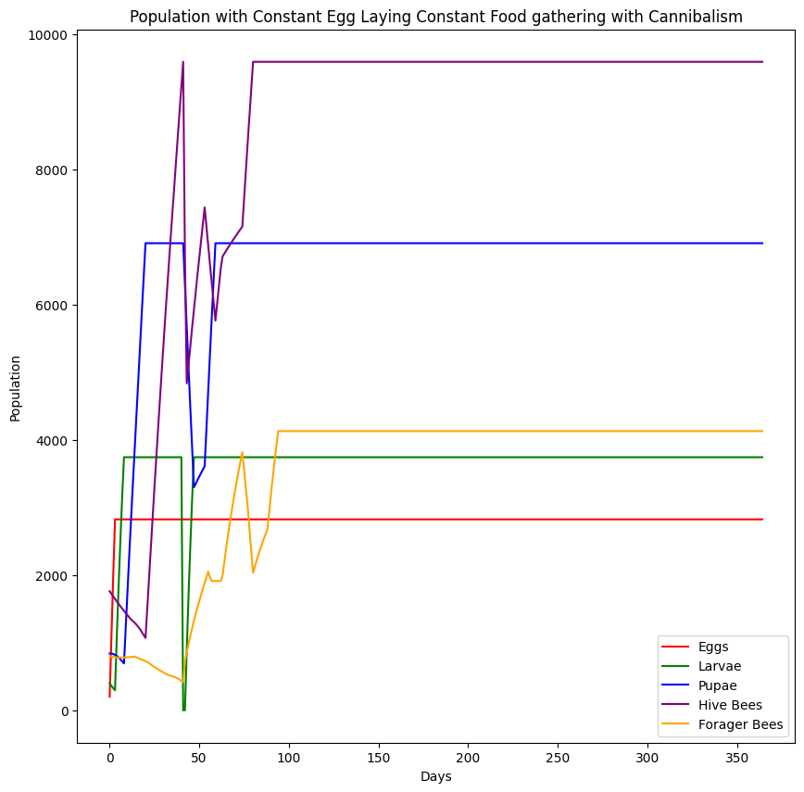
Cannibalism can save them
1000 eggs per day
1000 grams of Food on Day 1
0.1 grams per Forager
Initial Population 4000 Bees total
225 Eggs, 450 Larvae, 945 Pupae, 1980 Hive Bees, 900 Forager Bees
94% of Eggs survive, 92% of Larvae survive, 98% of Pupae survive, 98% of Hive bees survive, 90% of Forager Bees survive
Colony Can Survive

Slide 8
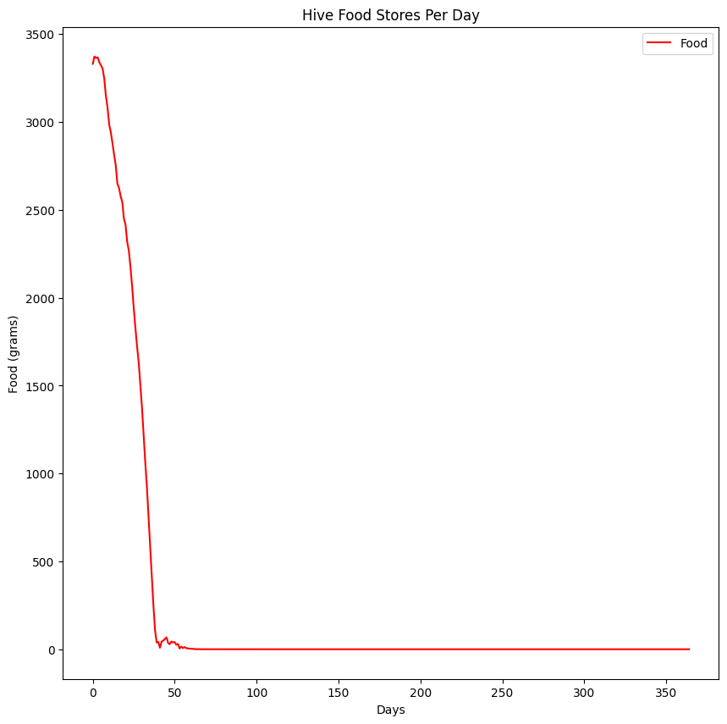
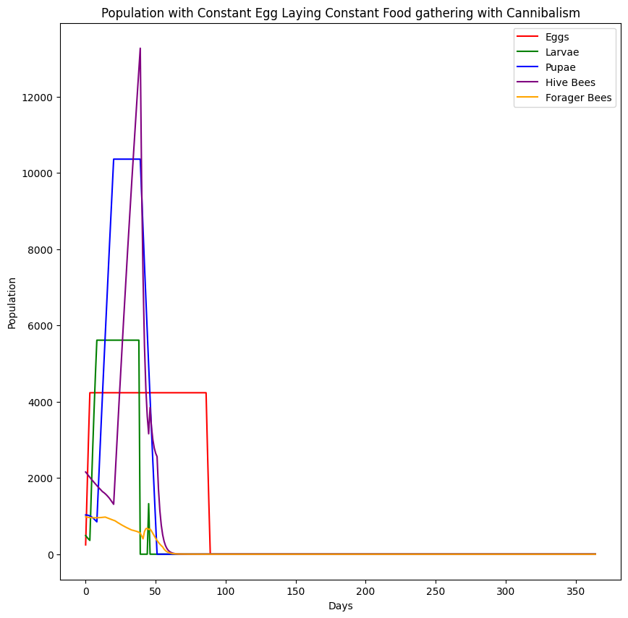
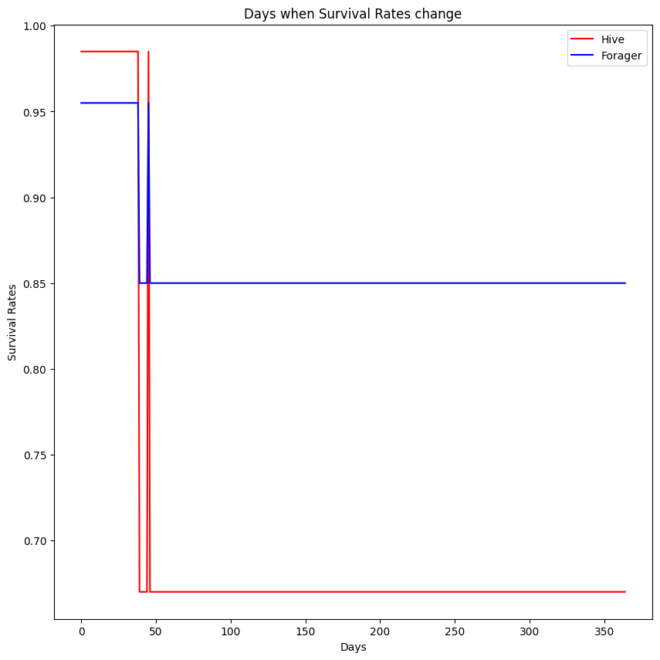
… But Usually, they all Die
Initially 4900 Bees
5000 grams of food on Day 1
Same Survival Rates and Consumption Rates

Slide 9
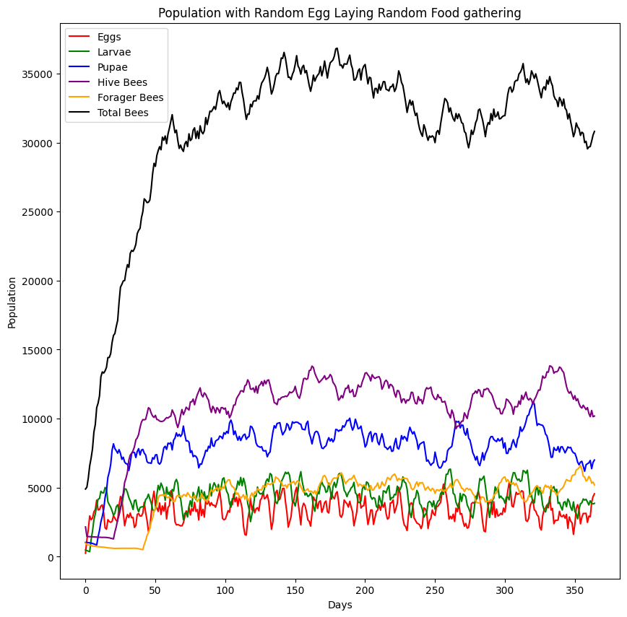
Adding Randomness
Random Initial Food
Random Egg Laying
Random Food Gathering
Fixed Consumption Rates
Cannibalism can occur

Slide 10
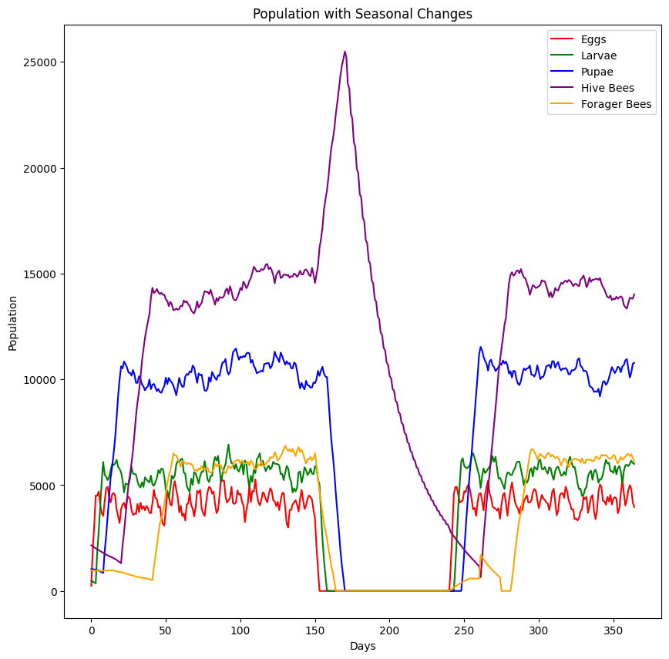
Seasonal Changes
During Summer, Spring and Fall – Eggs are laid, Foragers Forage, Survival Rates are fixed for everyone
During Winter – All Foragers Die, Everyone becomes a Hive Bee and a percentage of them die daily, Food stores are consumed for survival

Slide 11
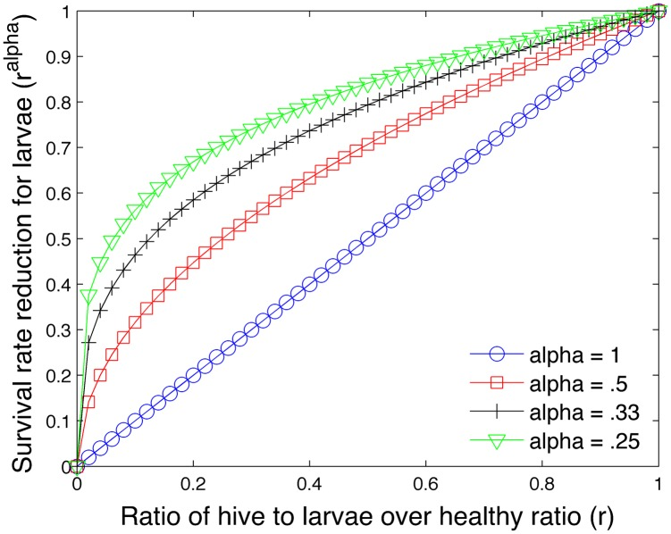
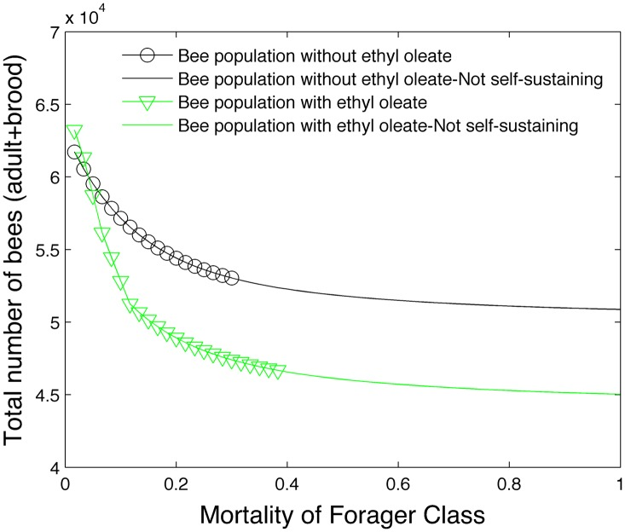
More Features
From Torres et al.

